Slide 1

Principles of Macroeconomics 3e
Chapter 6 THE MACROECONOMIC PERSPECTIVE
PowerPoint Image Slideshow

Slide 2
Ch.6 OUTLINE
6.1: Measuring the Size of the Economy: Gross Domestic Product
6.2: Adjusting Nominal Values to Real Values
6.3: Tracking Real GDP over Time
6.4: Comparing GDP among Countries
6.5: How Well GDP Measures the Well-Being of Society

Slide 3
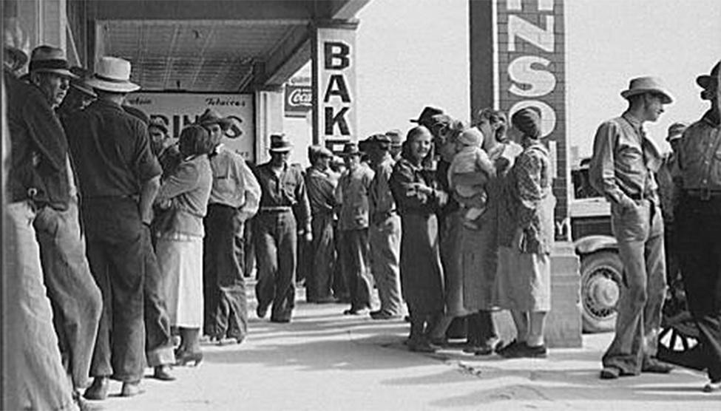
The Great Depression
At times, such as when many people have trouble making ends meet, it is easy to tell how the economy is doing.
This photograph shows people lined up during the Great Depression, waiting for relief checks.
At other times, when some are doing well and others are not, it is more difficult to ascertain how the economy of a country is doing.
(Credit: modification of "Waiting for relief checks. Calipatria, California" by Dorothea Lange/Library of Congress Prints and Photographs Division Washington, D.C. 20540 USA, Public Domain)

Slide 4
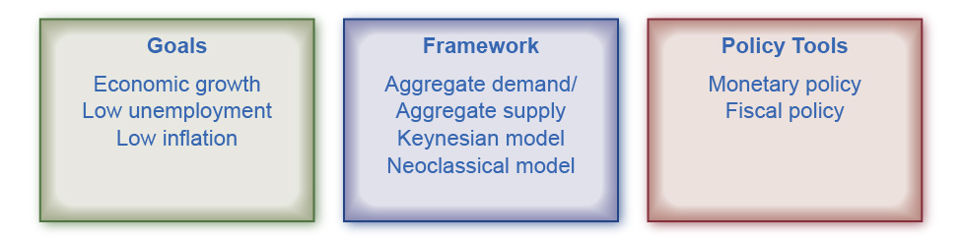
Macroeconomic Goals, Framework, and Policies
This chart shows what macroeconomics is about:
Goals - a consensus of what are the most important goals for the macro economy.
Framework - what economists use to analyze macroeconomic changes (such as inflation or recession).
Policy Tools - the tools the federal government uses to influence the macro economy.

Slide 5
6.1 Measuring the Size of the Economy: Gross Domestic Product
Gross domestic product (GDP) - the value of the output of all final goods and services produced within a country in a given year.
Measures the size of a nation’s overall economy.
An economy's GDP can be measured by either:
the total dollar value of what consumers purchase in the economy.
the total dollar value of what the country produces.
Every market transaction must have both a buyer and a seller, so GDP must be the same whether measured by what is demanded or by what is produced.

Slide 6
GDP Measured by Components of Demand
Who buys all of a country’s production?
Demand for production can be divided into four main parts:
consumer spending (consumption)
business spending (investment)
government spending on goods and services
spending on net exports

Slide 7
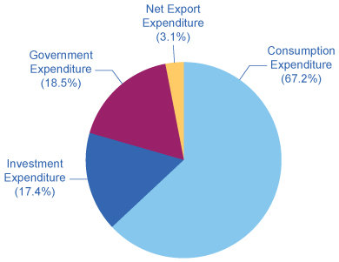
Percentage of Components of 2022 U.S. GDP on the Demand Side
Consumption makes up over half of the demand side components of the GDP. Totals in the chart do not add to 100% because the Net Export Expenditure, Exports minus Imports, is actually a negative 3.1%, as shown in Table 6.1. (Source: http://bea.gov/iTable/index_nipa.cfm, Table 1.1.10)

Slide 8
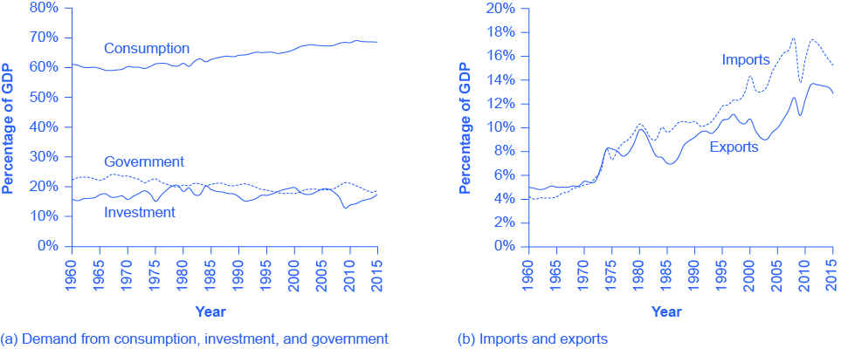
Components of GDP on the Demand Side
For graph (a):
Consumption is about two-thirds of GDP, but it moves relatively little over time.
Business investment hovers around 15% of GDP, but it increases and declines more than consumption.
Government spending on goods and services is around 20% of GDP.

Slide 9
Components of GDP on the Demand Side, Continued
For graph (b):
Exports are added to total demand for goods and services, while imports are subtracted from total demand.
If exports exceed imports, as in most of the 1960s and 1970s in the U.S. economy, a trade surplus exists.
If imports exceed exports, as in recent years, then a trade deficit exists. (Source: http://bea.gov/iTable/index_nipa.cfm, Table 1.1.10)

Slide 10
Net Export Component
The GDP net export component, or trade balance, is equal to the dollar value of exports (X) minus the dollar value of imports (M).
Trade balance - the gap between exports and imports.
Trade balance = (X – M)
Aka: “balance of trade” and “net exports”
Trade surplus - when a country’s exports are larger than its imports; calculated as exports – imports.
Trade deficit - when a country’s imports exceed exports; calculated as imports – exports.

Slide 11
GDP Using Demand
Based on the four components of demand, GDP can be measured as:
GDP = Consumption + Investment + Government + Trade balance
OR
GDP = C + I + G + (X – M)

Slide 12
GDP Measured by What is Produced
Production can be divided into five main parts:
Durable goods - long-lasting good like a car or a refrigerator.
Nondurable goods - short-lived good like food and clothing.
Services - product which is intangible (in contrast to goods) such as entertainment, healthcare, or education.
Structures - building used as residence, factory, office building, retail store, or for other purposes.
Change in inventories - good that has been produced, but not yet been sold.

Slide 13
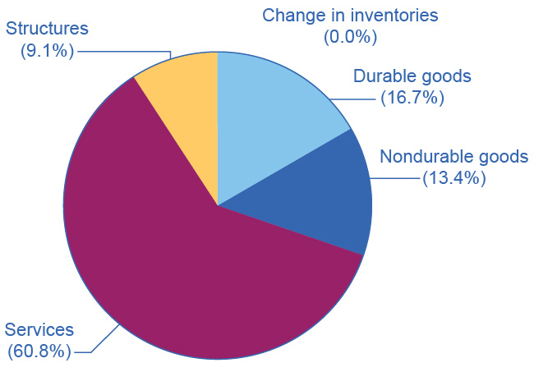
Percentage of Components of GDP on the Production Side
Services make up over 60 percent of the production side components of GDP in the United States.
Note that the change in inventories is not shown since it is typically less than 1% of GDP.

Slide 14
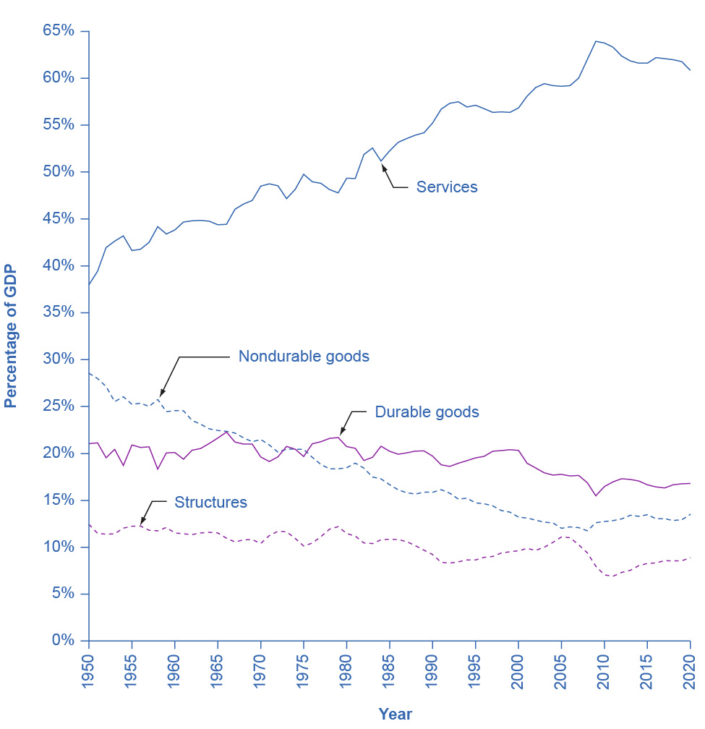
Types of Production
Services are the largest single component of total supply, representing over 60 percent of GDP, up from about 45 percent in the early 1950s.
Durable and nondurable goods constitute the manufacturing sector, and they have declined from 40 percent of GDP in 1950 to about 30 percent in 2016.

Slide 15
Types of Production, Continued
Nondurable goods used to be larger than durable goods, but in recent years, nondurable goods have been dropping to below the share of durable goods, which is less than 20% of GDP.
Structures hover around 10% of GDP.
The change in inventories is not shown here since it is typically less than 1% of GDP.

Slide 16
The Problem of Double Counting
Final goods and services - output used directly for consumption, investment, government, and trade purposes.
Goods at the furthest stage of production at the end of a year.
-vs.-
Intermediate goods - output provided to other businesses at an intermediate stage of production, not for final users.
Excluded from GDP calculation.
Double counting - output that is counted more than once as it travels through the stages of production.
A potential mistake to avoid in measuring GDP.
GDP is the dollar value of all final goods and services produced in the economy in a year.

Slide 17
Other Ways to Measure the Economy
Gross national product (GNP) - includes what is produced domestically and what is produced by domestic labor and business abroad in a year.
Gross national income (GNI) (aka: Net Foreign Factor Income) – includes the value of all goods and services produced by people from a country—whether in the country or not.
Net national product (NNP) - GNP minus the value of depreciation.
Depreciation - the process by which capital ages over time and therefore loses its value.
NNP can be further subdivided into:
national income - includes all income earned: wages, rent, interest and profit income.
personal income – only includes income to people

Slide 18
6.2 Adjusting Nominal Values to Real Values
Nominal value - the economic statistic actually announced at that time; not adjusted for inflation.
-vs.-
Real value - an economic statistic after it has been adjusted for inflation.
Generally, the real value is more important.

Slide 19
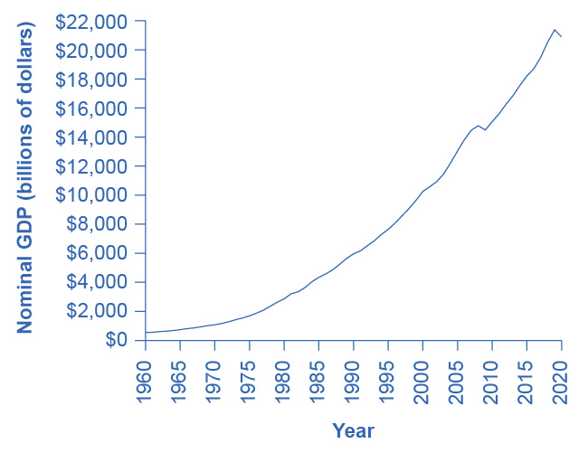
U.S. Nominal GDP, 1960–2020
Nominal GDP values have risen exponentially from 1960 through 2020, according to the BEA.

Slide 20
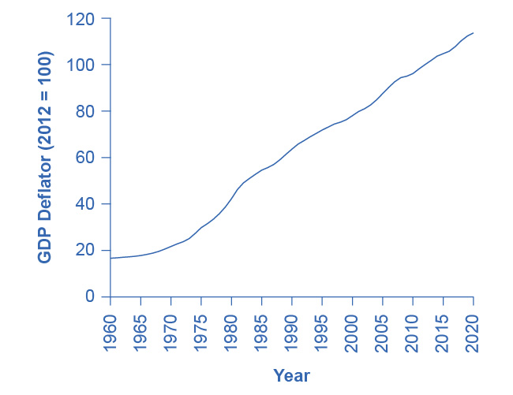
GDP Deflator, 1960–2020
The GDP deflator is a price index measuring the average prices of all goods and services included in the economy.
Much like nominal GDP, the GDP deflator has risen exponentially from 1960 through 2020. (Source: BEA, https://apps.bea.gov/itable/index.cfm, Table 1.1.9)

Slide 21
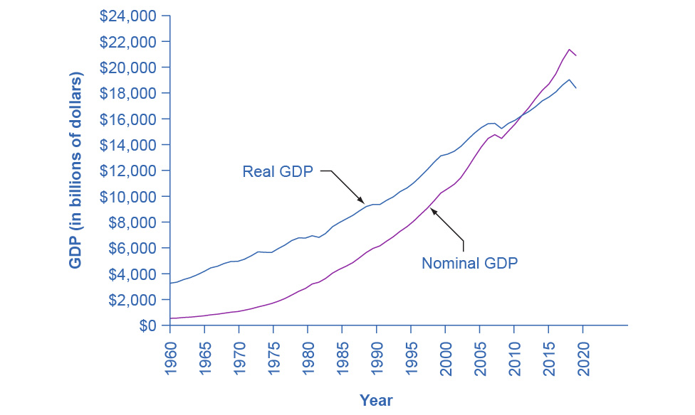
U.S. Nominal and Real GDP, 1960–2020
The black line measures U.S. GDP in real dollars, where all dollar values are converted to 2012 dollars.
Since we express real GDP in 2012 dollars, the two lines cross in 2012.
Real GDP will appear higher than nominal GDP in the years before 2012, because dollars were worth less in 2012 than in previous years.
Conversely, real GDP will appear lower in the years after 2012, because dollars were worth more in 2012 than in later years.

Slide 22
6.3 Tracking Real GDP over Time
Governments report GDP growth as an annualized rate.
When analyzing growth in a quarter, the calculated growth in real GDP for the quarter is multiplied by four when it is reported (as if the economy were growing at that rate for a full year).
Recession - a significant decline in national output/GDP.
Depression - an especially lengthy and deep decline in output.

Slide 23
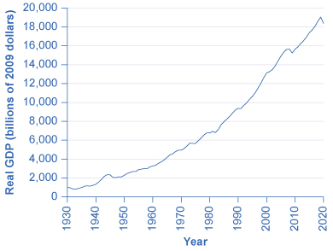
U.S. GDP, 1930–2020
Real GDP in the United States in 2020 (in 2012 dollars) was about $18.4 trillion.
After adjusting to remove the effects of inflation, this represents a roughly 20-fold increase in the economy’s production of goods and services since 1930. (Source: bea.gov)

Slide 24
Patterns of Recessions and Expansions
Peak - during the business cycle, the highest point of output before a recession begins.
Contraction – a decrease in economic output
Trough - during the business cycle, the lowest point of output in a recession, before a recovery begins.
Expansion – an increase in economic output
A recession lasts from peak to trough, and an economic upswing (recovery)runs from trough to peak.

Slide 25
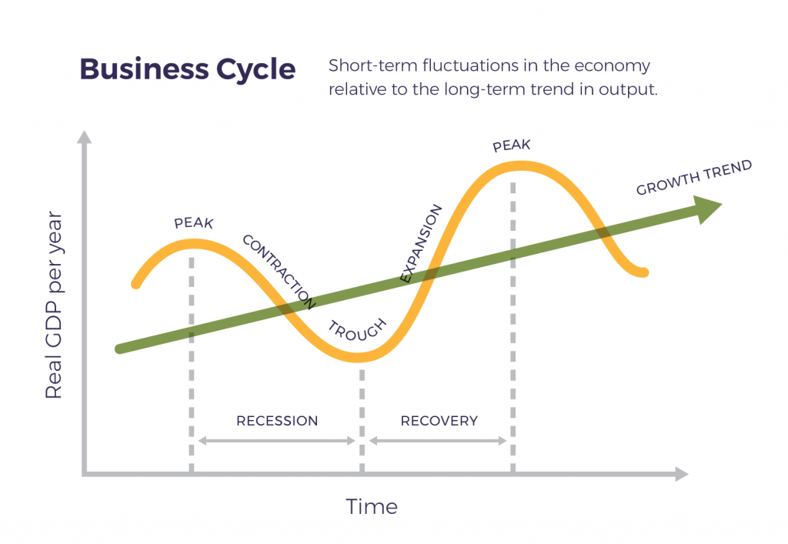
This Photo by Unknown Author is licensed under CC BY-SA-NC

Slide 26
6.4 Comparing GDP among Countries
To compare the GDP of countries with different currencies, it is necessary to convert to a “common denominator” using an exchange rate.
Exchange rate - the value or price of one currency in terms of another currency.

Slide 27
Example: Converting GDP to a Common Currency
Example: Compare Brazil’s GDP in 2020 of 7.4 trillion reals with the U.S. GDP of $20.9 trillion for the same year.
In 2020, the exchange rate was 2.362 reals = $1.
Convert Brazil’s GDP into U.S. dollars:
Brazil's GDP in $U.S. = Brazil's GDP in reals
Exchange rate (reals/$ U.S.)
= 7.4 trillion reals
2.362 reals per $ U.S.
= $3.1 trillion GDP
Compare this value to the GDP in the United States in the same year.
The U.S. GDP was $20.9 trillion in 2020, which is almost seven times that of GDP in Brazil.

Slide 28
GDP Per Capita
The U.S. economy has the largest GDP in the world, and is also a populous country.
Is its economy also larger on a per-person basis?
GDP per capita - the GDP divided by the population.
GDP per capita = GDP
population

Slide 29
6.5 How Well GDP Measures the Well-Being of Society
Standard of living - all elements that affect people’s happiness and well-being, whether they are bought and sold in the market or not.
Difference between GDP and standard of living.
GDP does not include:
leisure time
actual levels of environmental cleanliness, health, and learning
production that is not exchanged in the market
the level of inequality in society
what technology and products are available

